Slide 1
Probability & Statistics for Engineers & Scientists
Authors: Walpole, Myers, Myers, YE
Instructor:
Osama Bin Ajaz
Lecturer, S & H Dept.,
FAST-NU, Main Campus, Karachi
osama.ajaz@nu.edu.pk

Slide 2
Measures of Central Tendency (Mean, Median, Mode)

Slide 3
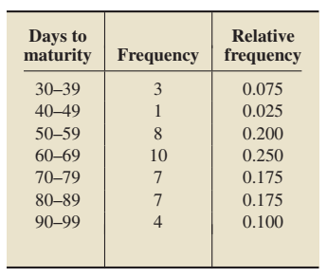
Example # 10: The Mean
Reconsider Example # 09:

Slide 4
Example # 11: The Median
Reconsider Example # 10 and calculate Median.

Slide 5
Example # 12: The Mode

Slide 6
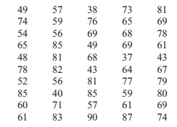
Notes:
35 – 41, 42 – 48, 8 classes.
Mean=66.1, Median=66, Mode=62.5, 62.5, 80 (from group data)

Slide 7
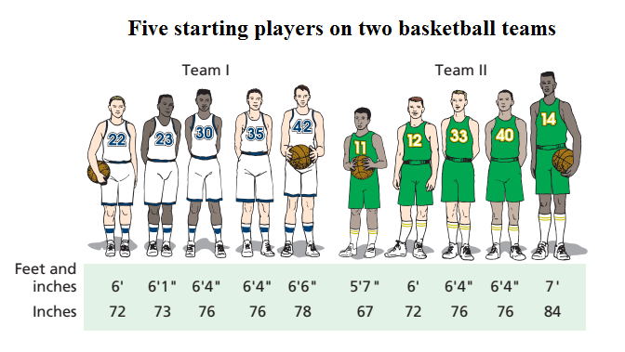
Measures of Variation
Two or more data sets can have same mean, median or mode, but those datasets may differ in other aspects.
Notes:
Mean = 75 inches (6.3) Median = 76 inches (6.4) Mode = 76 inches ( 6.4)

Slide 8
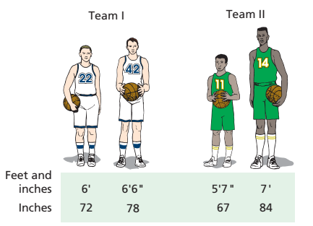
Measures of Variation: RANGE

Slide 9
Measures of Variation: The Standard Deviation

Slide 10
Example 14:
Use the following data set: 10, 20, 30, 40, 50 to find:
Standard deviation
Add 5 to each value, and then find the SD.
(c) Subtract 5 from each value and find the standard deviation.
(d) Multiply each value by 5 and find the SD.
(e) Divide each value by 5 and find the SD.
Notes:
(a) 15.81 (b) 15.81 (c) 15.81 (d) 79.06 (e) 3.16

Slide 11

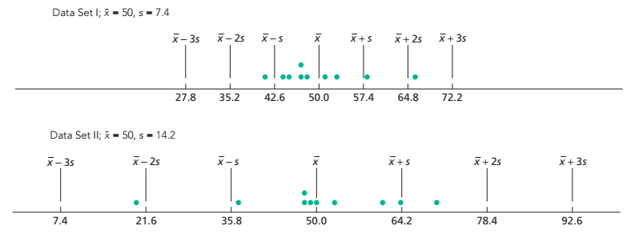
Further Interpretation of Standard Deviation

Slide 12
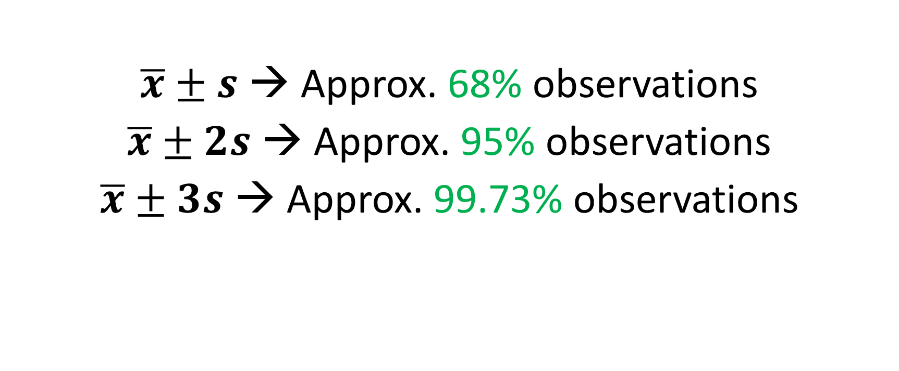
For a bell-shaped curve following empirical rule hold
$\overline{x}±s$ → Approx. 68% observations
$\overline{x}±2s$ → Approx. 95% observations
$\overline{x}±3s$ → Approx. 99.73% observations

Slide 13
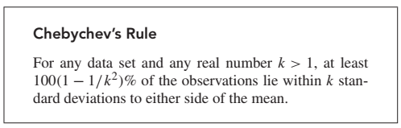
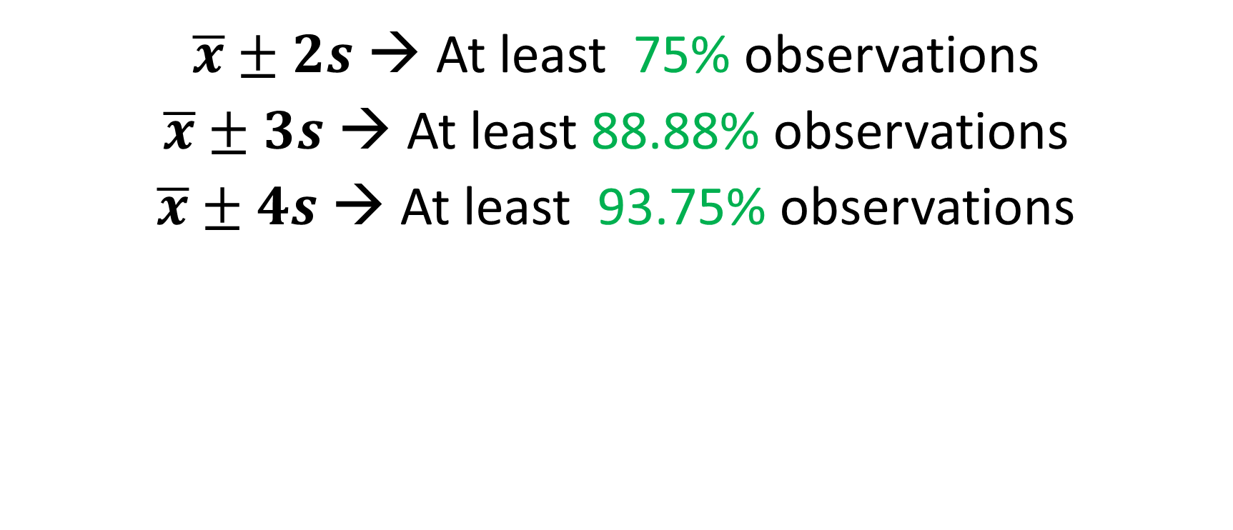
CHEBYCHEV’S RULE
$\overline{x}±2s$ → At least 75% observations
$\overline{x}±3s$ → At least 88.88% observations
$\overline{x}±4s$ → At least 93.75% observations

Slide 14
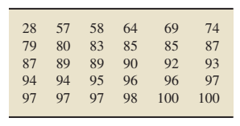
Example # 15: Exam Scores
Consider the following sample of exam scores,
arranged in increasing order. The sample mean and
Sample standard deviation of these exam scores are,
respectively, 85 & 16.1.
Use Chebychev’s rule to obtain a lower bound on the percentage of observations that lie within two and three standard deviations to either side of the mean.
Use the data to obtain the exact percentage of observations that lie within two standard deviations to either side of the mean. Compare your answer.

Slide 15

Measures of Variation: The Coefficient of Variation
A statistic that allows you to compare standard deviations when the units are different is called the coefficient of variation.
Example # 16

Slide 16
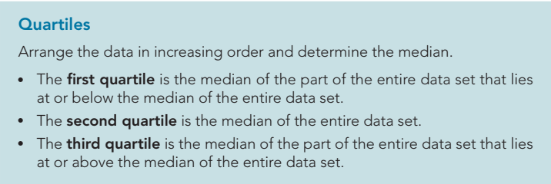
Quartiles

Slide 17
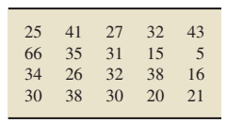
Example # 17: Quartiles (Contd.) (Weekly TV-Viewing Times)
The A. C. Nielsen Company publishes information on the TV-viewing habits of Americans in Nielsen Report on Television. A sample of 20 people yielded the weekly viewing times, in hours, displayed in the table below. Determine and interpret the quartiles for these data.
Solution:

Slide 18
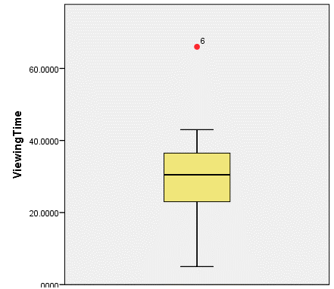

Example # 18: Box Plot
It represents 5 number summary:
Reconsider Weekly Viewing Times data:

Slide 19
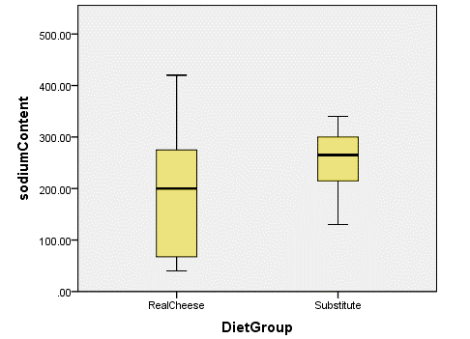
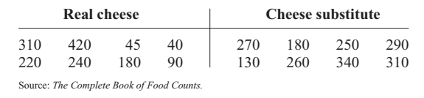
Example # 19: Box Plot
A dietitian is interested in comparing the
sodium content of real cheese with the
sodium content of a cheese substitute.
The data for two random samples are shown.
Compare the distributions, using boxplots.
Notes:
Real Cheese: Q1=67.5, Q2=200, Q3=275, Min=40, Max=420
Cheese Substitute: Q1=215, Q2, 265, Q3=300, Min=130, Max=340

Slide 20
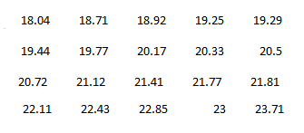
Trimmed Mean
According to the journal of Chemical Engineering, an important property of a fiber is its water absorbency. A random sample of 20 pieces of cotton fiber was taken and the absorbency on each piece was measured. The following are the absorbency values:
(a) calculate the sample mean and median for the above sample values.
(b) Compute trimmed mean.
Notes:
Q1 = 19.32, Q2=20.61, Q3=22.03, Mean = 20.76, Mode = 18.04
20Trimmed=

Slide 21
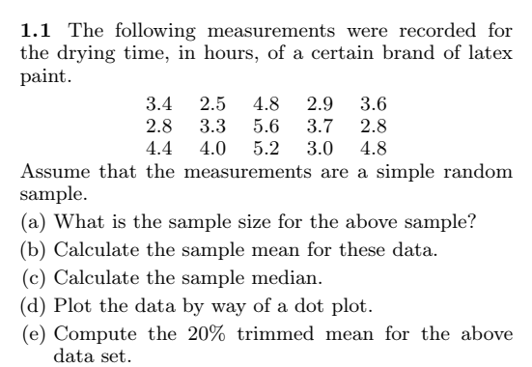
Trimmed Mean (contd.)
Notes:
3/15=20%

